Slide 1

Hand Gesture Recognition using Moments ss
Project guide:
Rahul Chakravorty
Presented by :
Akash Dubey
Dr. A.P.J. Abdul Kalam Technical University,Uttar Pradesh,Lucknow

Slide 2
Contents
Introduction
Steps of Hand Gesture Recognition
Codebook Method
Feature Extraction using Moments
Krawtchouk Moments
Classification using K Nearest Neighbours
Results
Conclusion
Future Work
References

Slide 3
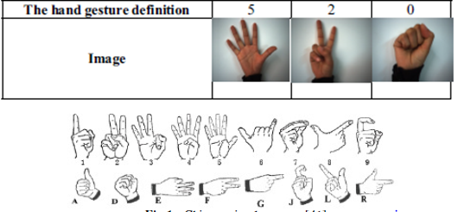
Introduction
Why gesture recognition?
•Important for Human Computer Interaction(HCI).
•Should be made easy, natural and convenient, without gloves.
•Games control, robotics control, virtual reality, and smart homes systems

Slide 4
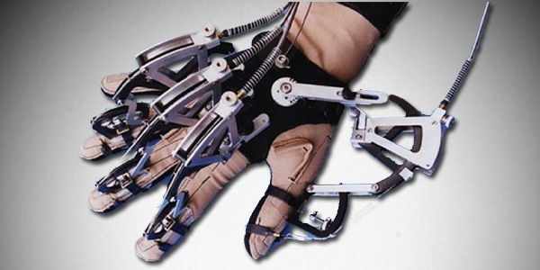
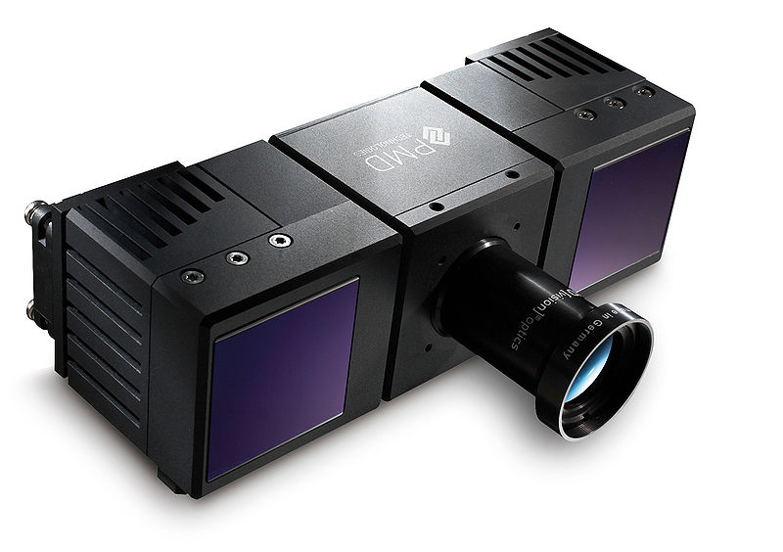
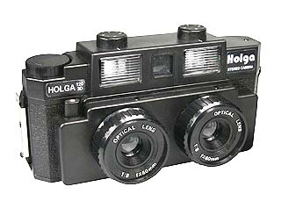
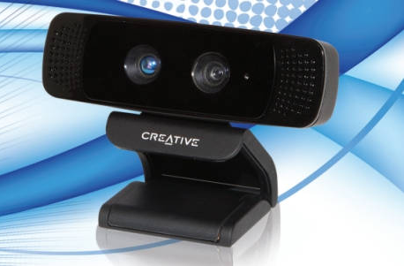
Existing techniques
Wired gloves.
Depth-aware cameras.
Stereo cameras.
Controller-based gestures.
Single camera.

Slide 5
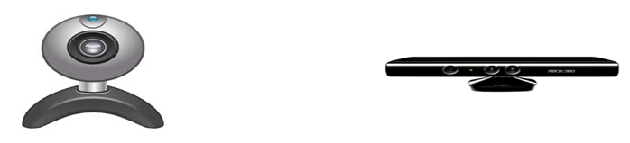
Challenges to these techniques
Hardware limitation – expensive & not commonly used.
Poor Image quality, hand segmentation is a difficult task.

Slide 6
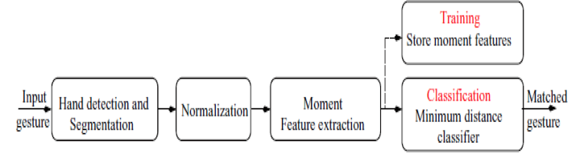
Steps Of Hand Gesture Recognition

Slide 7
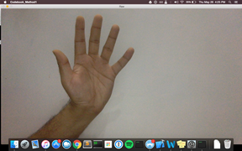
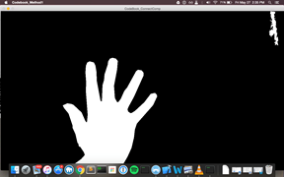

Steps Of Hand Gesture Recognition
Image Capture It can be done either with single camera or with
two or more cameras.
Hand detection and segmentation Extract hand from image background
Normalization The binary hand images are normalized for orientation changes and scale variations

Slide 8
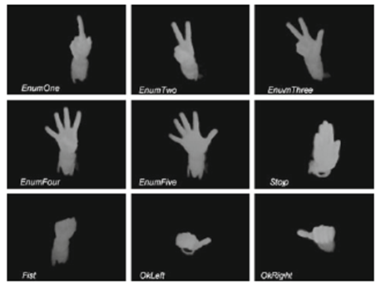
Steps Of Hand Gesture Recognition
Moment Feature Extraction The moments computed from the normalized hand gesture image form the feature vectors. These features can be used to determine meaning of a given gesture.
Classification Classification mainly consists of finding the best matching reference features for the features extracted in the previous phase. Classification is done using the minimum distance classifier.

Slide 9

Hand Segmentation
Initialize Background Capture
Find the foreground by subtracting foreground images from CodeBook Model (cvBGCodeBookDiff)
Convert Captured RGB image into YUV
(cvCvtColor)
Train the CodeBook Model
(cvBGCodeBookUpdate)
Remove the blots and holes from the image
(cvSegmentFGMask)
Image Capture
(cvQueryFrame)
Initialize Foreground Capture

Slide 10


Training and Classification
Calculate Hypergeometric function
(hypergeom2F1.m)
Calculate Pochhammer Symbol
(pochhammersym.m)
Input the set of images to populate the database
Sort and label the images according to file names
(sort_nat.m)
Find Krawtchouk moments
(krawtchoukmoment.m)
Create the feature vector for training
(createFeatureVector.m)
Results
Knn Classification
(knnclassification.m)
Test image by creating its feature vector
(test_image.m)

Slide 11
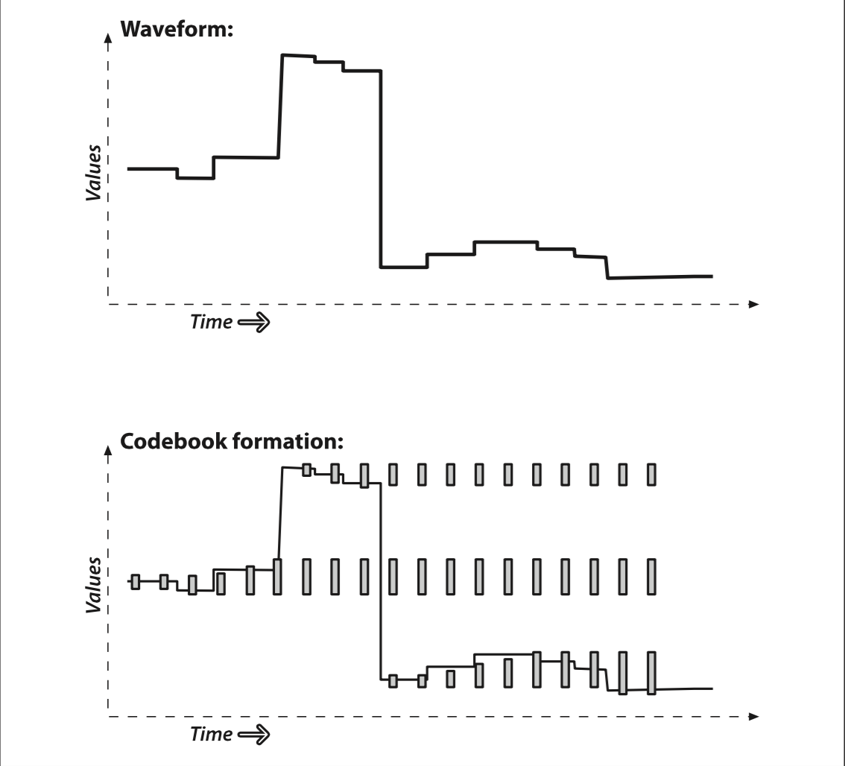
Codebook Method
Code Book

Slide 12
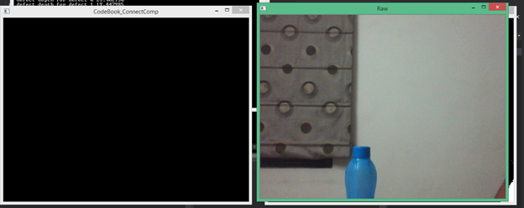
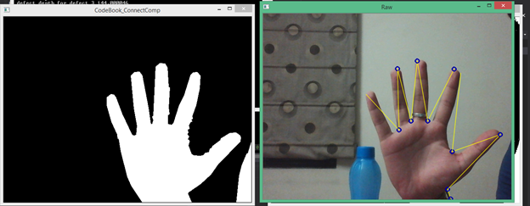
Codebook Method
1. Codebook formed from background images
2. Array of codebooks equal to number of pixels in image
3. Input image compared with Codebook model
Segmented Image
Input image
4. For each pixel, min-max bounds are searched
5. If matched, then black returned else white
Notes:
Note.. 255 for each channel = white coloe, 0 = black color

Slide 13
Codebook Method
A variable, stale, is used which denotes the longest span of time during which the codebook was not accessed
Tracking stale entries allows us to delete codebooks that were formed from noise or moving foreground objects
During background learning, if codebook entry is not accessed for some time, then it is marked for deletion.

Slide 14


Feature Extraction using Moments
An image moment is a certain particular weighted average of the image pixel intensities
For a 2D continuous function f(x,y) the moment of order (p + q) is defined as
For p,q = 0,1,2,... Adapting this to scalar (grayscale) image with pixel intensities I(x,y), raw image moments M_{ij} are calculated by

Slide 15
Types of Moments
Orthogonal Moments
Cartesian/Non-orthogonal
Continuous
Discrete
Hu Moments
Legendre
Zernike
(polar)
Tchebichef
Krawtchouk
Notes:
Sartaj add new slide below it and copy paste

Slide 16
Moment Invariants
An invariant is a property which remains unchanged when transformations of a certain type are applied to the objects.
Translation Invariant It can be achieved simply by seemingly shifting the object such that its
centroid coincides with the origin of the coordinate system
Scale Invariant It can be achieved by normalization of each moment by a non zero moment
Rotation Invariant The moments are invariant with respect to any rotation

Slide 17
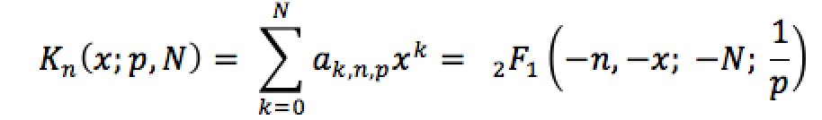
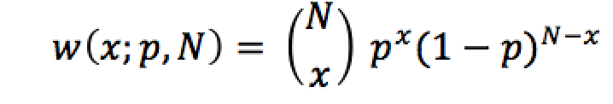
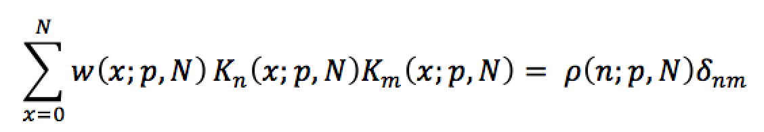
Krawtchouk Polynomial
Krawtchouk Moments, based on Krawtchouk polynomials
Discrete Orthogonal
Set of discrete basis functions with weight function:
These satisfies the orthogonality condition

Slide 18
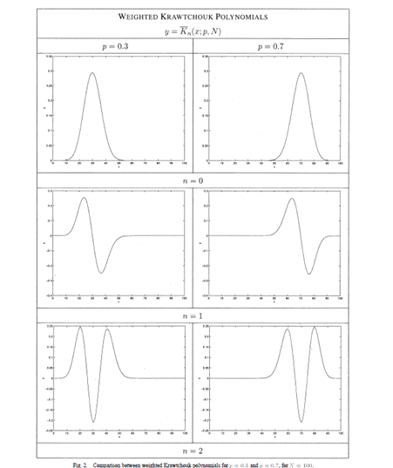
Krawtchouk Polynomial
Extract local Features by
varying value of p
Region of interest(ROI) is
selected by varying p
Changing ‘n’ changes the order

Slide 19
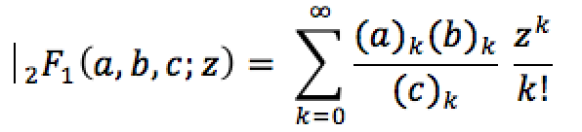
Krawtchouk Polynomial
The definition of n-th order classical Krawtchouk polynomial is defined as:
where x, n = 0, 1, 2,….,N, N > 0, p ∈ (0,1)
₂F₁ is the hypergeometric function defined as

Slide 20
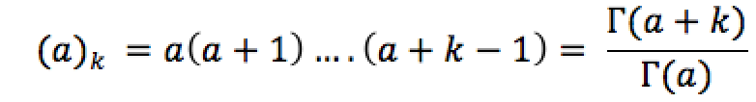
Krawtchouk Polynomial
And (a)_{k} is the Pochhammer symbol given by :

Slide 21
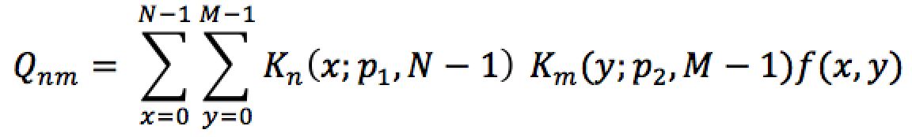
Krawtchouk Moments
Order (m+n)
Image intensity function f(x,y)
Higher order moments store information about the image

Slide 22
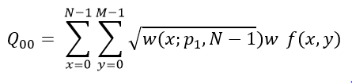
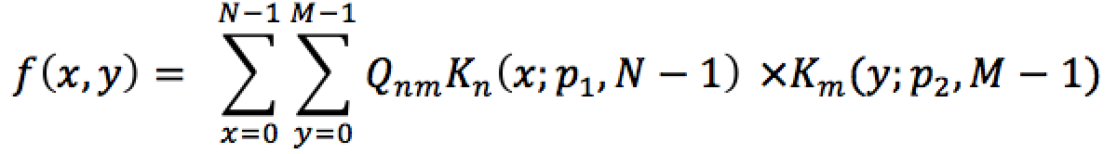
Krawtchouk Moments
The Krawtchouk moment corresponding to n = m = 0 is the weighted mass of the image, i.e.,
Hence the image intensity function can be written completely in terms of the Krawtchouk moments, i.e.,

Slide 23


Hypergeometric function
Given by
Takes time to calculate as
where, p Є (0,1), and this goes on till a very big number
Recursive form used

Slide 24
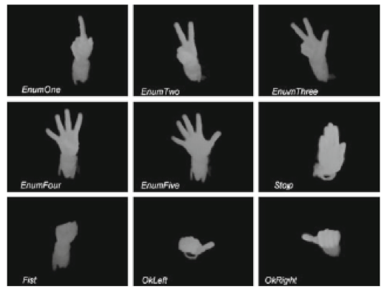
Classification using K Nearest Neighbours
Classification mainly consists of finding the best matching reference features for the features extracted in the previous phase.
Classification is done using the minimum distance classifier.

Slide 25
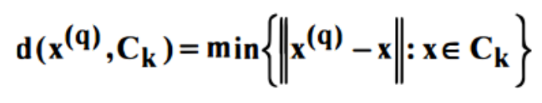
Knn Classifier Algorithm
Compare the feature vector of the prototype image and the feature vectors stored in the database
Obtained by calculating the Euclidean square distance between the feature vectors of the prototype image and the database
Feature vector with minimum difference is found to be the nearest matching vector
Expression for minimum distance is given by :

Slide 26
Steps of Knn Classifier Algorithm
Population of the Database
Find Higher Order Krawtchouk Moments
Repeat steps 1-3 to create a matrix
Input Image
Create Feature Vector

Slide 27
Steps of Knn Classifier Algorithm
Testing Knn Scheme
Find Higher Order Krawtchouk Moments
Calculate Minimum Distance from each vector
Test Image
Create Feature Vector

Slide 28
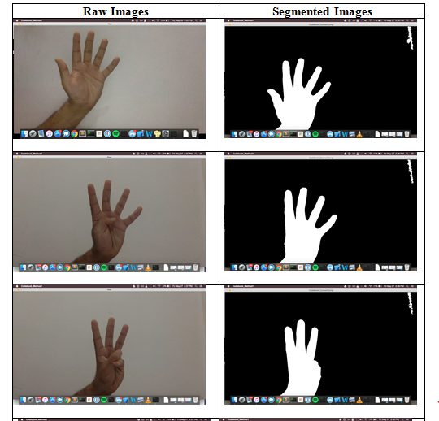
Results of segmentation
Raw Images Segmented Images

Slide 29
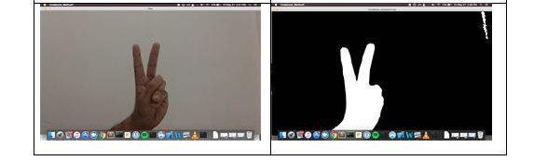
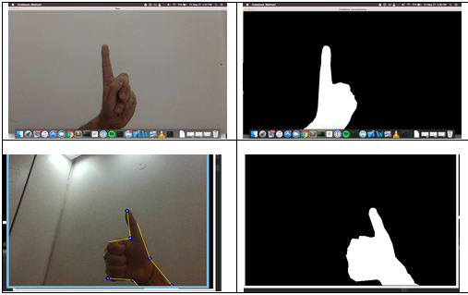
Results of segmentation
Raw Images Segmented Images

Slide 30






Results (Classified images)
5 3 4
2 1 6

Slide 31
Results
Table 1: Krawtchouk moments results without transformation (Number of training samples in Dataset 300)
Table 2: Krawtchouk moments results with transformation (Number of training samples in Dataset 300)
No of testing samples | Correct classification (CC) | Percentage CC
100 | 92 | 92%
No of testing samples | Correct classification (CC) | Percentage CC
70 | 62 | 88.57%

Slide 32
Results
Table 3: Comparison of time using different forms of hypergeometric functions
Hypergeometric function | No of testing samples | Runtime
Recursive method | 36 | 62.98 (seconds)
Iterative method | 36 | 267.3 (minutes)

Slide 33
Conclusion
Images successfully segmented using Codebook.
Krawtchouk polynomials and the associated Moments used to create feature vectors.
The Knn classifier used to find the closest match to the input image and hence classify it.

Slide 34
Future Work
Even more faster calculations so that it can be used in real time video processing.
Better accuracies of gesture recognition.
Interfacing with the machine.

Slide 35
References
[1] Ong and Ranganath, “Automatic Sign Language Analysis: A Survey and the Future Beyond Lexical Meaning,” IEEE Trans. Pattern Anal. Mach. Intell., vol. 27, no. 6, pp. 873–891, June 2005.
[2] A. Chalechale, F.Safaei, G.Naghdy, and P.Premaratne, “Hand Posture Analysis for Visual based Human Machine Interface,” in Proceedings of the Workshop on Digital image Computing, pp. 91–96, July 2005.
[3] C.-C. Chang, J. J. Chen, W.-K. Tai, and C.-C. Han, “New Approach for Static Gesture Recognition,” Journal of Information Science and Engineering, vol. 22, pp. 1047–1057, January 2006.
[4] L. Gu and J. Su, “Natural Hand Posture Classification based on Zernike Moments and Hierarchial Classifier,” in Proceedings of the Internatinal Conference on Robotics and Automaton. IEEE, pp. 3088–3093, May 2008.
[5] P.T.Yap, P.Raveendran and S.H.Ong, "Image Analysis by Krawtchouk Moments", IEEE Transaction on Image Processing, Vol. 12, No II, pp1367-1377, November 2003.
[6] P.T.Yap, P.Raveendran and S.H.Ong, "Krawtchouk Moments as a New Set of Discrete Orthogonal Moments for Image Reconstruction", Proceeding of the 2002 International Joint Conference on Neural Networks, VoU, pp 908-912,12-17 th May 2002.
[7] P.T.Yap, P. Ravendran, S.H.Ong, "Chebychev Moments as a New Set of Moments for Image Reconstruction", Proceeding of IEEE, Kuala Lumpur, pp 2856-2860, December 2001.
[8] S. Padam Priyal and Prabin. K. Bora, "A study on static hand gesture recognition using moments", Conference on Signal Processing, Bangalore, pp. 1-5, 18-21 July 2010
[9] Gary Bradski, Adrian Kaehler, (September 2008) “Learning OpenCV”, OReilly Media, pp 281-285.
[10] A. J. Nor'aini, “A comparative study of face recognition using discrete orthogonal moments” 10th International Conference on Information Science, ISSPA, Kuala Lumpur, pp. 197 - 200, 10-13 May 2010

Slide 36
THANK YOU!

